Slide 1

Common C-RNN architecture for Key and Tempo estimation
Rino Castellano - @TUWIEN 2021-2022

Slide 2
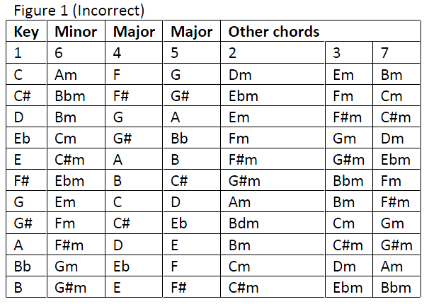
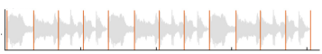
Key and Tempo
Relative fifth
Relative minor
Key is the main chord of the composition where the entire chord progression and note execution lives around
The tempo is defined by the BPM (Beats per Minute) and it is also crucial to a better knowledge and live execution of the song
0.6 s
If BPM=100

Slide 3
Pipeline
Pre-processing 1. Cutting audio 2. STFT and Mel filter-bank
Model Building -> CRNN Architecture
Insights

Slide 4
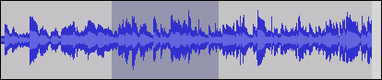
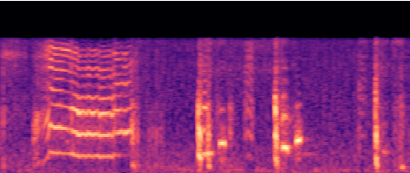
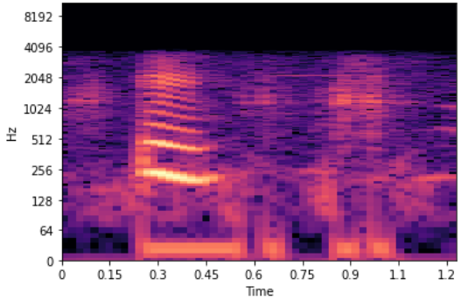
Pre-processing
1. Cutting audio in its first 15s, because:
No necessity of longer audio for training
Data augmentation (discussed in the insights)
(…)

Slide 5
Pre-processing
2. Transformation from audio signal into spectrogram:
STFT, window_length=1024, hop_size=612
Change measure from Hz -> Db
Filter-bank Mel
Logarithmic filter
(…)

Slide 6
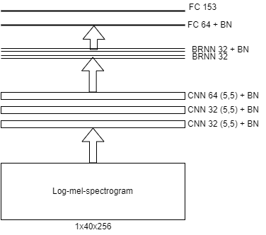
Modeling
CRNN schema for classification task:
24 outputs in Key Estimation
140 outputs in BPM Estimation
CRNN used for its benefits gained in long short time readability.

Slide 7
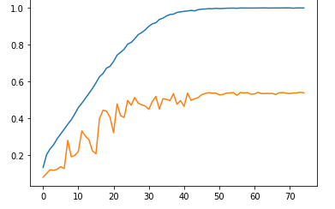
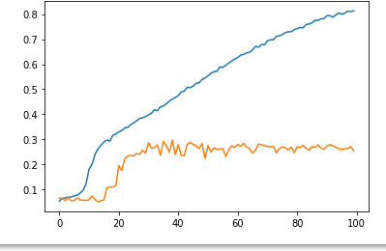
Evaluation
Key
Estimation
@acc1
For Tempo Estimation:
@acc1=50%
@acc2=70% (described in the insights)
For Key Estimation:
@acc1= 30%
@acc2= 50% (described in the insights)
Tempo estimation
@acc1

Slide 8
Insights
Initially the purpose was to use two different architecture that would had estimate the Tempo and Key simoultaneosly, but :
No existing large dataset with both information predefined
Hard handcrafting computation for feature extraction
Library inefficient in the estimation of Key and Tempo (librosa)
Only one common CRNN architecture, with differences in the setting of parameters, hyperparameters and kernel regularizers..

Slide 9
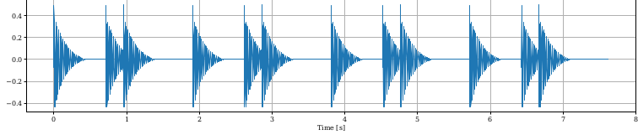
Insights
New accuracy used:
Tempo Estimation: @acc2 tolerance of 8% + tolerance with doubled and halved BPM The @acc2=70%
Key Estimation: @acc2 considering the weighting error of relative fifth,minor, major The @acc2=50%
80 bpm -> 160 bpm
Relative fifth
Relative minor

Slide 10
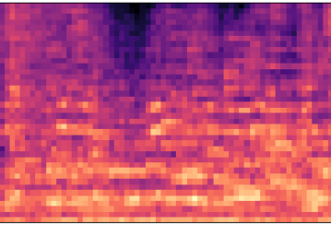
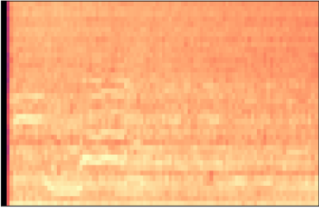
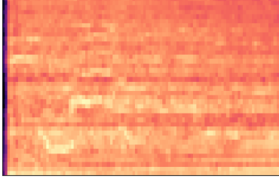
Insights
Data Augmentation:
Time Stretching (Tempo Estimation)
Pitch Shifting (Key Estimation)
Using cut -> remnants of the parts cut at the beginning
Time
stretching
Pitch shifting
Overfitting still remained. Possible interpretation in Tempo Estimation -> Few Shot Learning

